Slide 1
Tutorial of pipeline for pre-processing OMETIFF from femtonics

Slide 2
Outline
Features
Easy to use
Download from Github
Launch Pipeline Interface
Start ConvertOMETIFF to TIFF

Slide 3
Features
ConvertOMETIFF
✓ Separate channels only
✓ Separate channels and planes both
Suitable for xy-t and xyz-t data, also xyz data (skip step2 & 3)
Registration
Can use static channel to register dynamic channel
channel 1 or 2 as dynamic (such as GCaMP) are suitable.
The parameters of registration will be saved.
CropROI
The size info of cropped image will be saved for possible usage in the future
Can check data with more than 10 planes
Final dataset is set as AVG plane to have a better view for cropping

Slide 4
1. Go to github and download files
Download files from github (https://github.com/pywugate/PipelineInterface)
Tools from other people
NoRMCorre (https://github.com/flatironinstitute/NoRMCorre)
BioFormats for matlab (https://www.openmicroscopy.org/bio-formats/downloads/)
Multipage TIFF stack (https://www.mathworks.com/matlabcentral/fileexchange/35684-multipage-tiff-stack)
There are some modifications in files from those tools, they are renamed with suffix “_vPingYen”, such as
“bfopen_vPingYen.m”
“twimshow_PingYen.m”
“normcorre_batch_even_uint16_vPingYen.m”

Slide 5
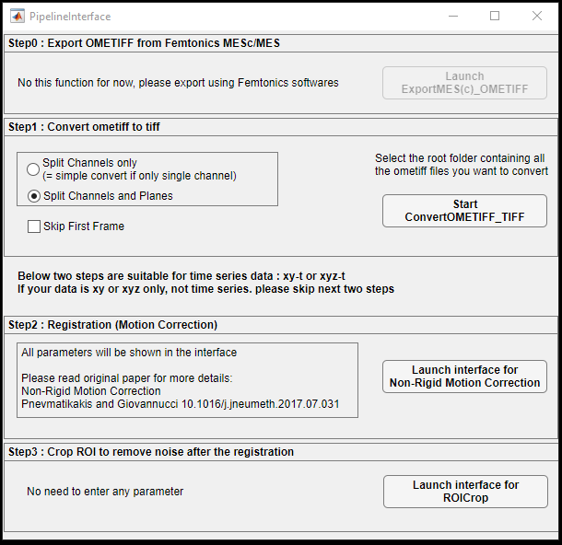
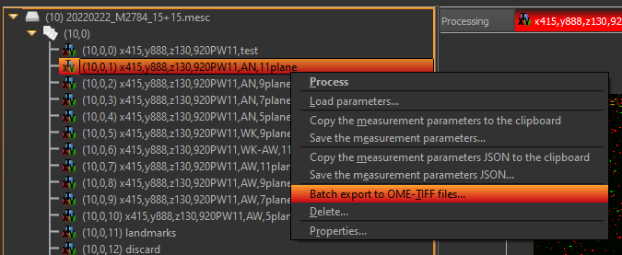
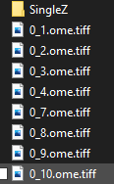
2. Run the PipelineInterface.mlapp
Make sure you already export OMETIFF from femtonics software

Slide 6
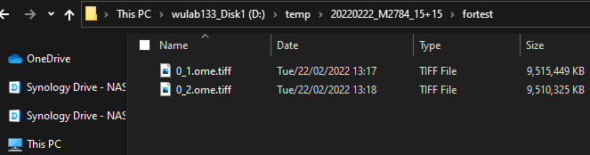
3. Convert OMETIFF to TIFF
Decide the separation choice
Decide skipping first frame or not
Click “Start ConvertOMETIFF_TIFF”
Select the “Root” folder

Slide 7
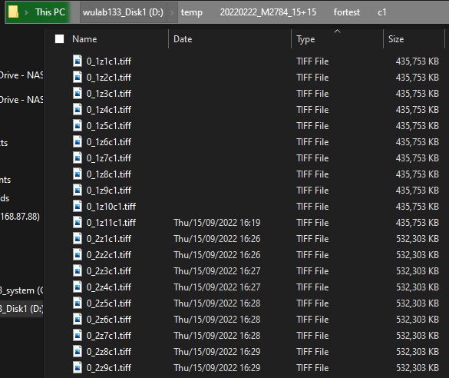
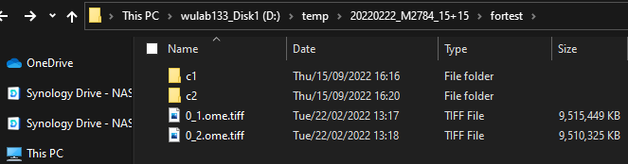
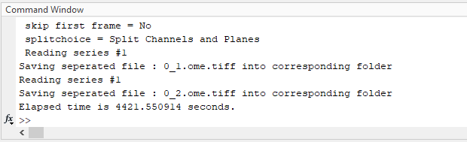
Result after Start ConvertOMETIFF_TIFF

Slide 8
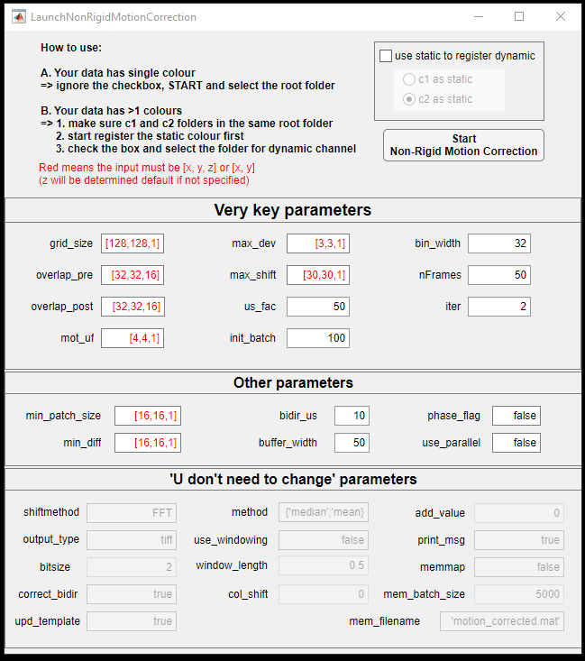
4. Run Registratoin
Make sure understand the parameters (https://github.com/flatironinstitute/NoRMCorre)
Check how many colours the data has
1 colour
2 colours: c1 as static or c2 as static
Change the parameters in the same format
Click “Start Non-Rigid Motion Correction”

Slide 9
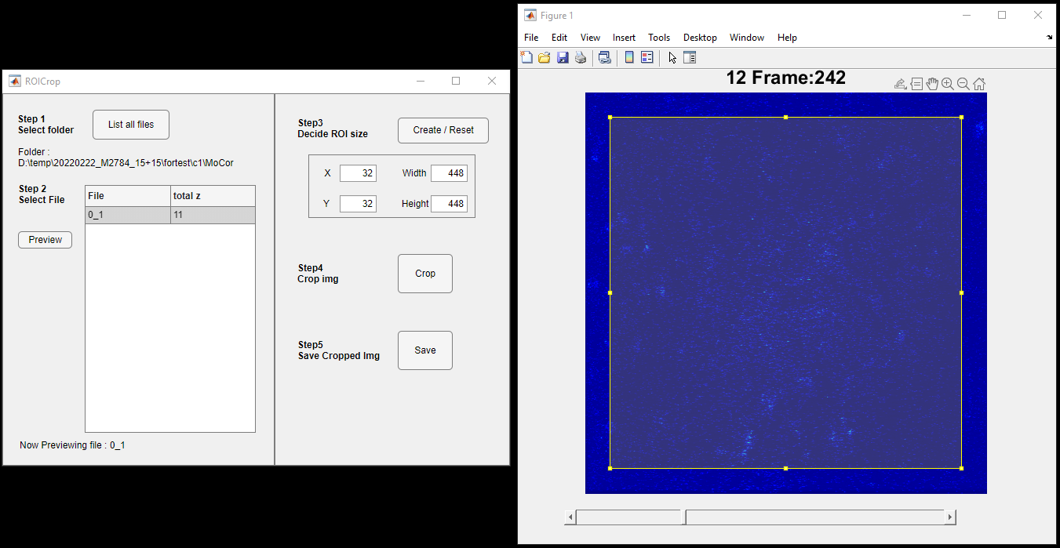
5. Crop the image after registration
Launch the interface
Choose the folder
Choose the data and preview
Use arrow keys to move frames
Use “Q” and “W” to change datasets e.g.: The data contains 11 planes, Q will go backwards dataset while W go forwards.
The final dataset will be averaged plane

Slide 10
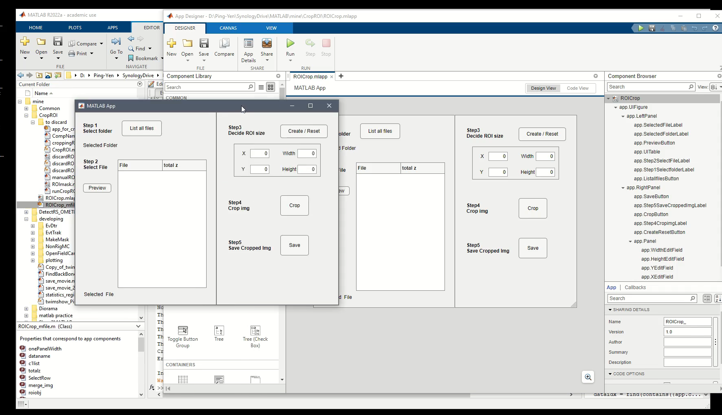
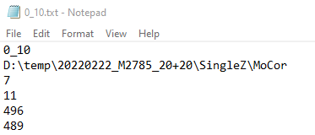
After cropping
Suffix “_crp” is given to cropped data
Info will be saved in txt file
Data name
Folder path
Position [left, bottom, width, height]
Do next analysis
Video demo of ROICrop interface

